Slide 1
Paper plane launching machine
GUIDE NAME : PRASHANT. N. PATIL​
NAME​ | ROLL NO​ | USN​
Sandeep​ | 1126​ | 01FE24BEC039​
Sonika​ | 1145​ | 01FE24BEC103​
Priyanka​ | 1121​ | 01FE24BEC033​
Gayatri​ | 1122​ | 01FE24BEC034​
Prateek​ | 1123 | 01FE24BEC035​

Slide 2
OUTLINE
 | PROBLEM DEFINITION
 | GENERATED CONCEPTS
 | SELECTED CONCEPTS
 | VIRTUAL IMPLEMENTATION
 | PHYSICAL IMPLEMENTATION

Slide 3
PROBLEM DEFINITION
Design a portable paper plane launching machine with dimensions of 2 cubic feet, of weight ~ 1.5 kg, and of cost ₹3000.Various mechanisms for error handling, and plane stabilization. A high level of automation, using transparent acrylic sheets, and ease of portability which should be aesthetically good looking.

Slide 4
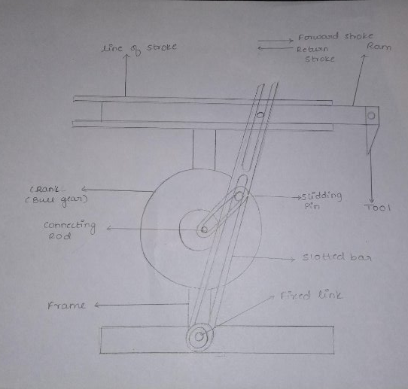
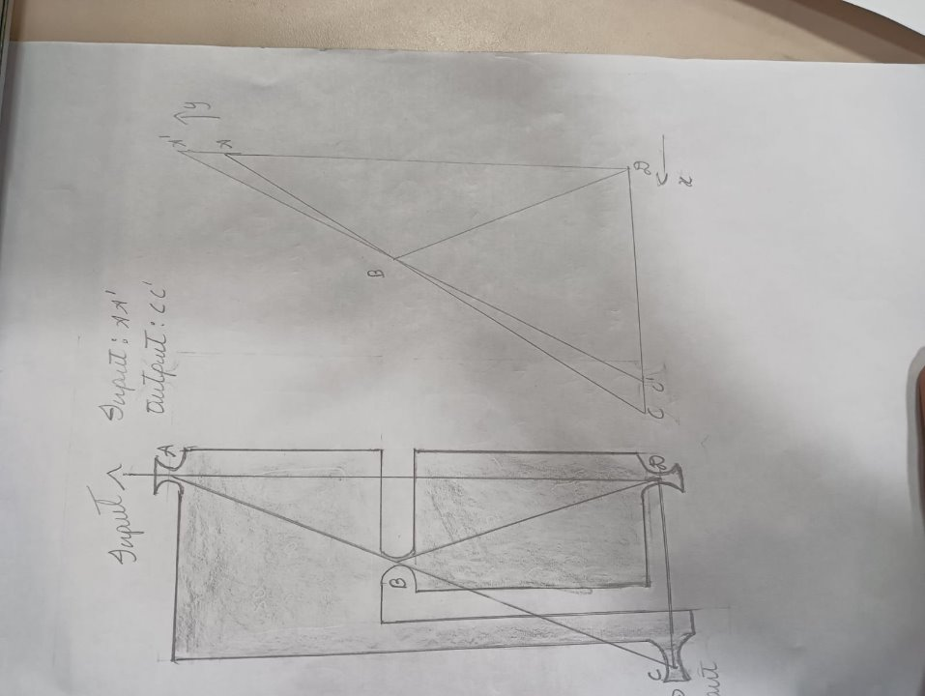
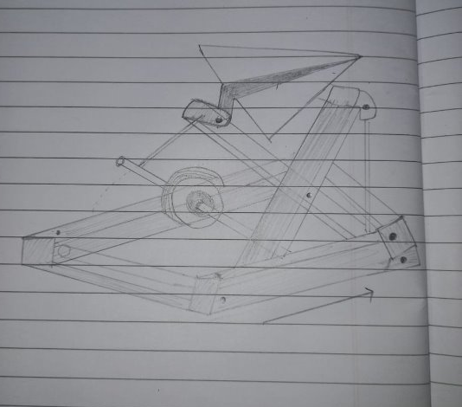
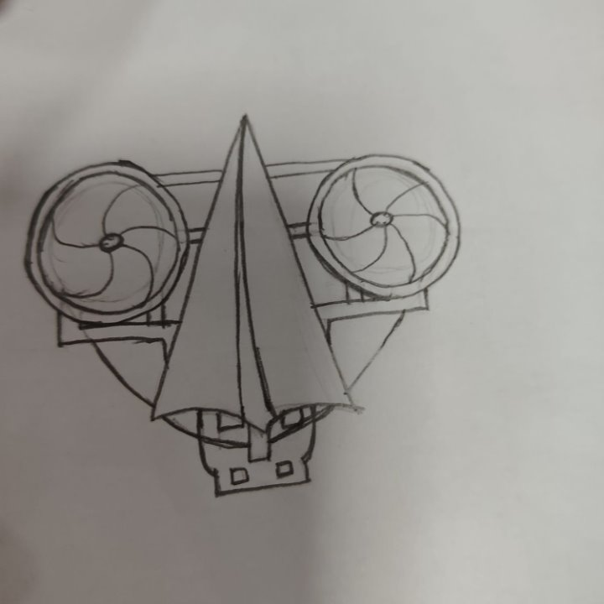
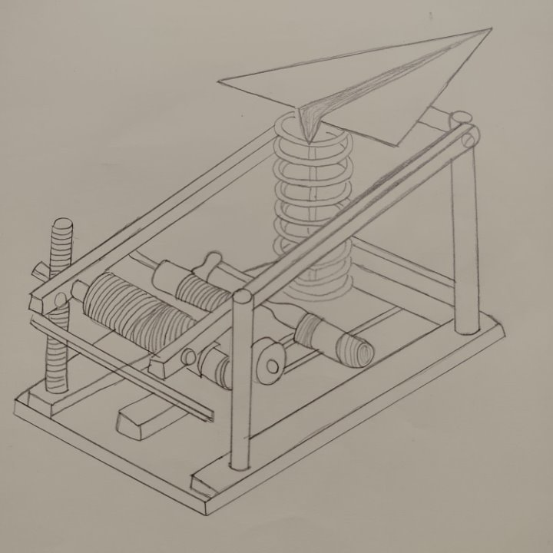
GENERATED CONCEPTS​
QUICK REVERSE MECHANISM
SCOTT MECHANISM
CATAPULT MECHANISM
COUNTER WHEEL MECHANISM
SPRING BARREL MECHANISM

Slide 5
SELECTED CONCEPTS
COUNTER WHEEL MECHANISM

Slide 6
VIRTUAL IMPLEMENTATION​

Slide 7
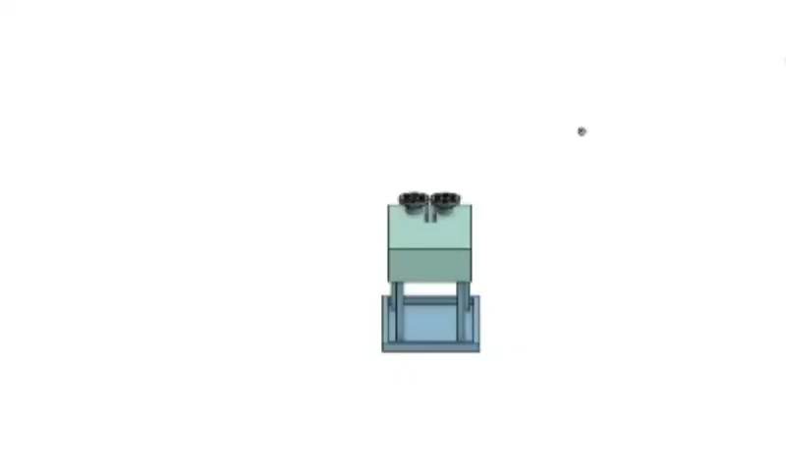
3D MODEL OF THE ENTIRE SYSTEM​

Slide 8
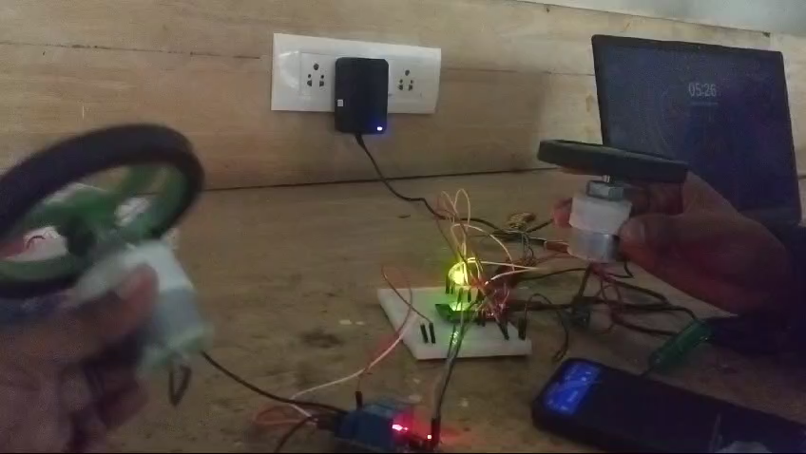
CIRCUIT DIAGRAM OF ENTIRE SYSTEM​ ​

Slide 9
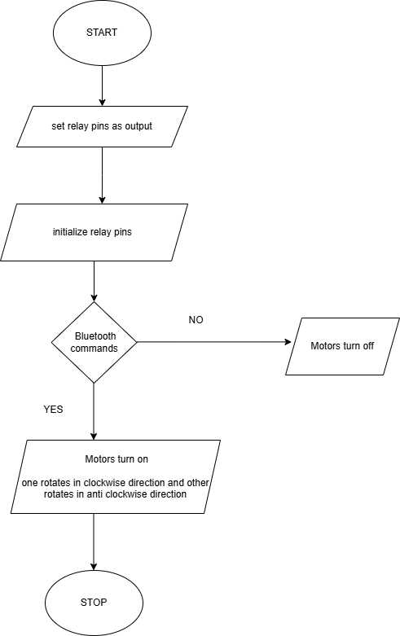
FLOWCHART

Slide 10
PHYSICAL IMPLEMENTATION​

Slide 11
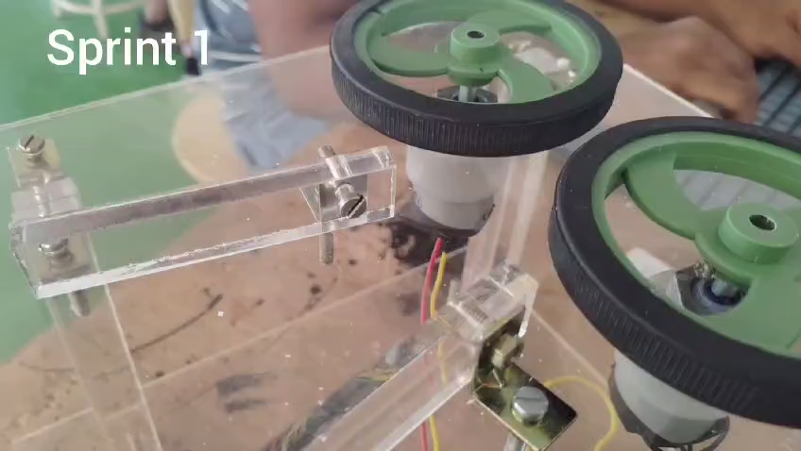

Slide 12
LEARNINGS FROM THIS COURSE PROJECT​
We have learnt to design and construct a simple yet effective mechanism.​
We have learnt the importance of teamwork for problem solving and tackle design challenges.​
To complete the project within a given timeframe while meeting the design goals.​
Using microcontroller to control the motor and launching by a semi-automatic process.​
Choosing durable materials to construct the machine for optimal performance.​

Slide 13
Thank you​

